Slide 1
Lynx management& consequences of EC interference
Linda Dombrovska, Latvian Hunters’ Association

Slide 2


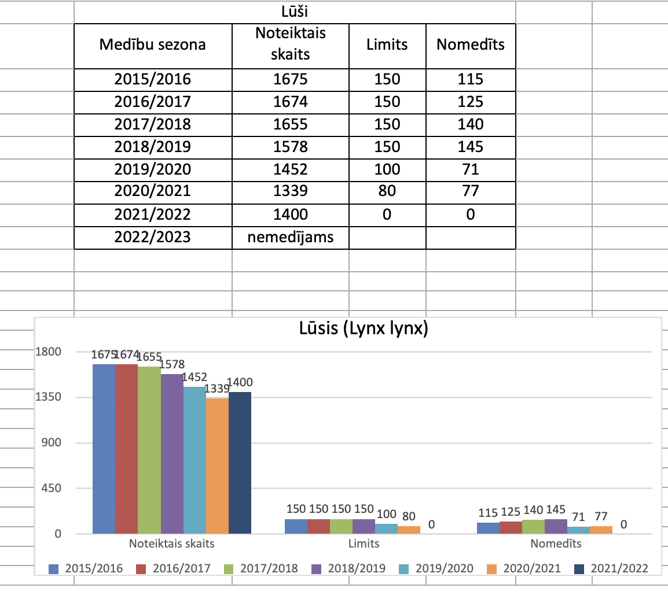
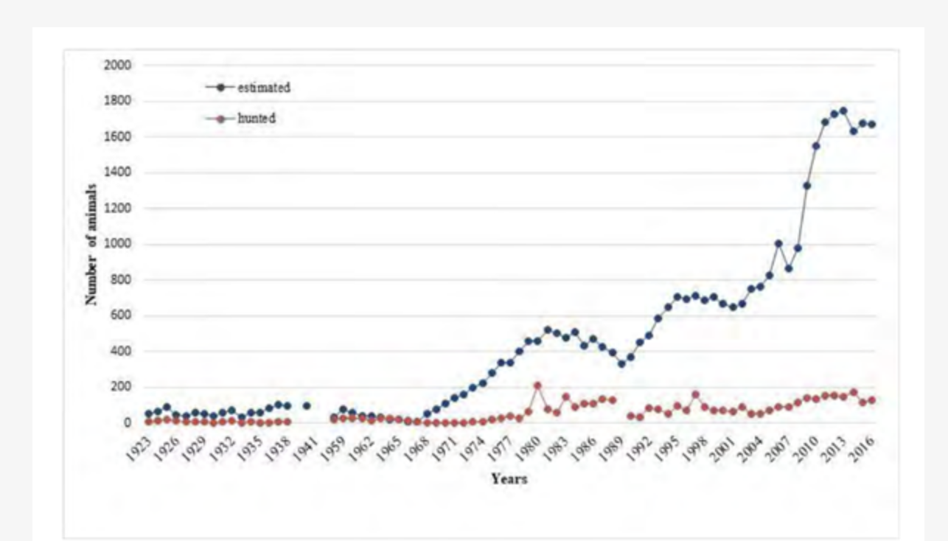

Lynx had always been hunted, since 2004. Annex IV
z

Slide 3
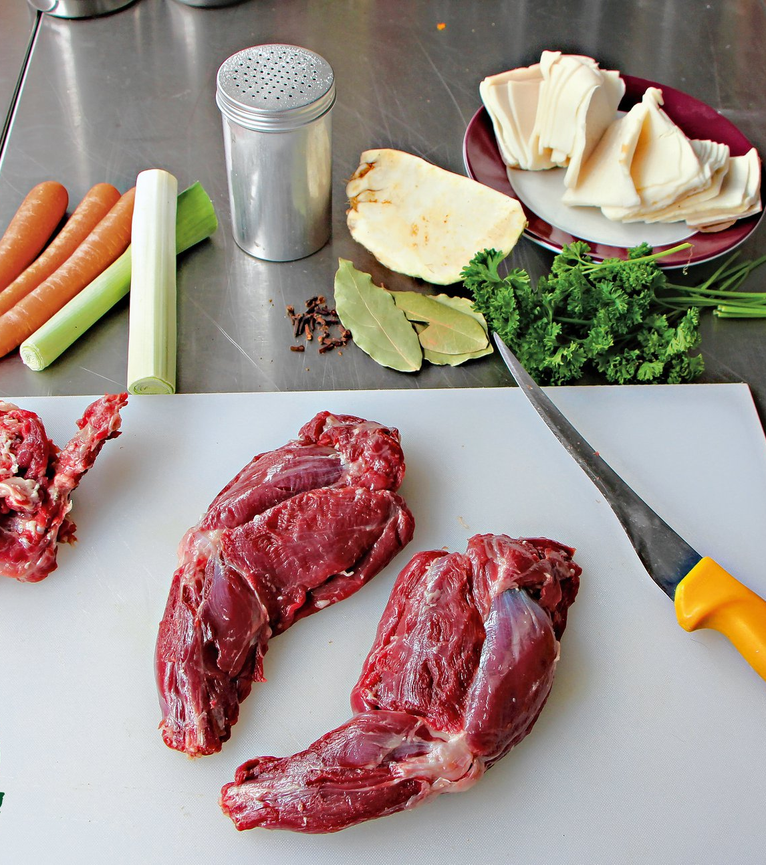
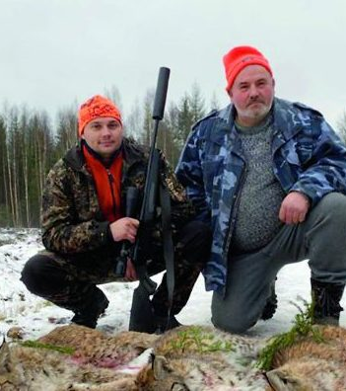
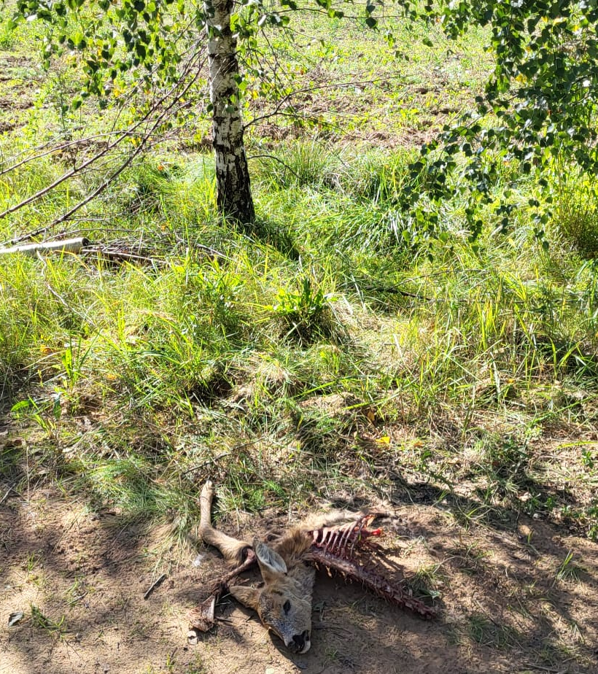
Arguments for hunting
z

Slide 4
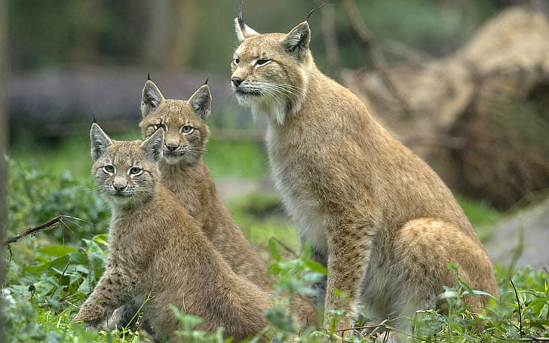
Children, do not have uprotected sex!

Slide 5
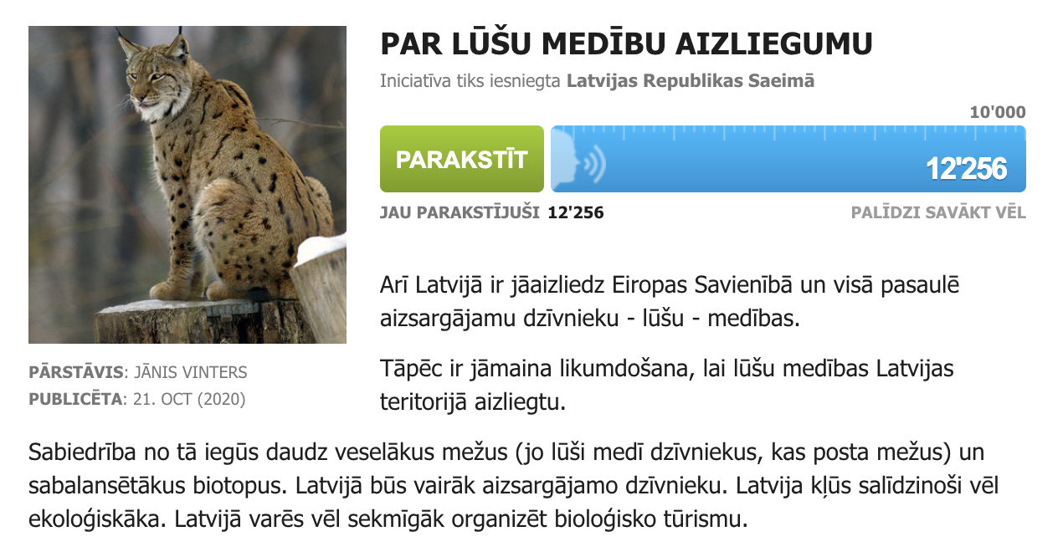
Public initiative!
Main argument: “We have not seen many lynx while walking a dog!”

Slide 6
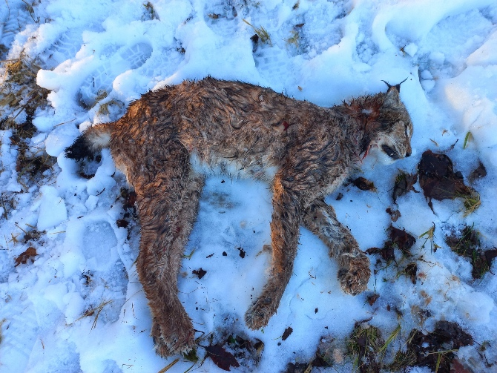
Back to self regulatory issue!
Estonia: probably killed by wolves

Slide 7
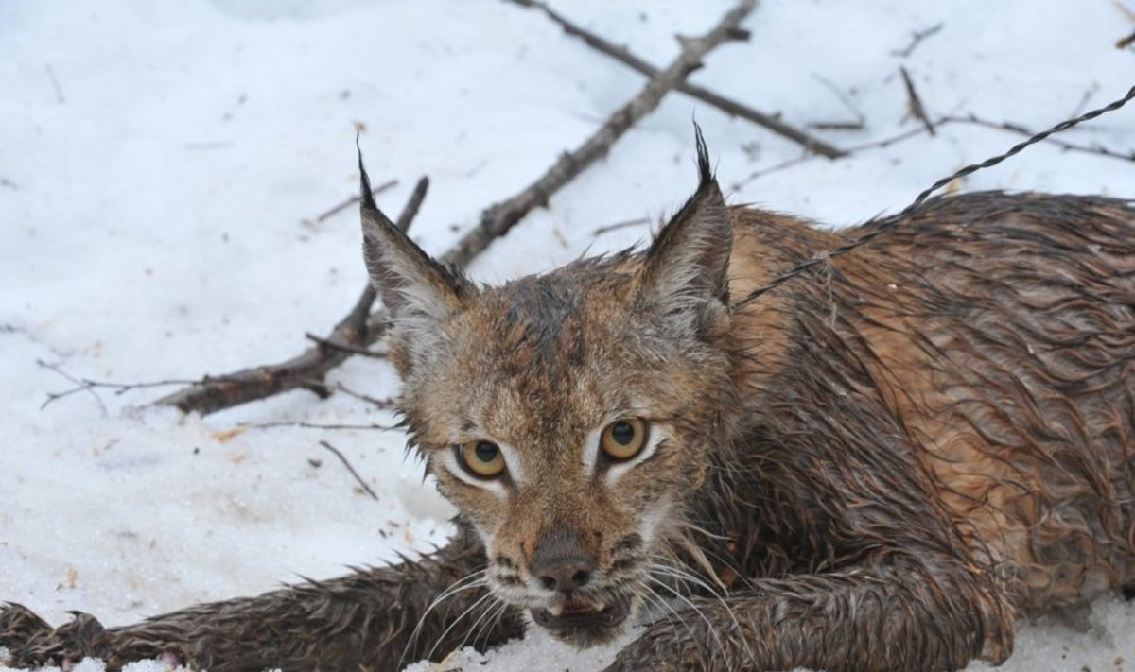
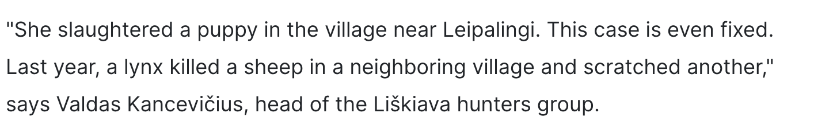
In Lithuania
z

Slide 8
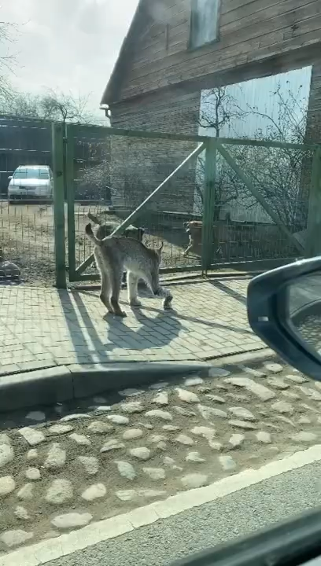
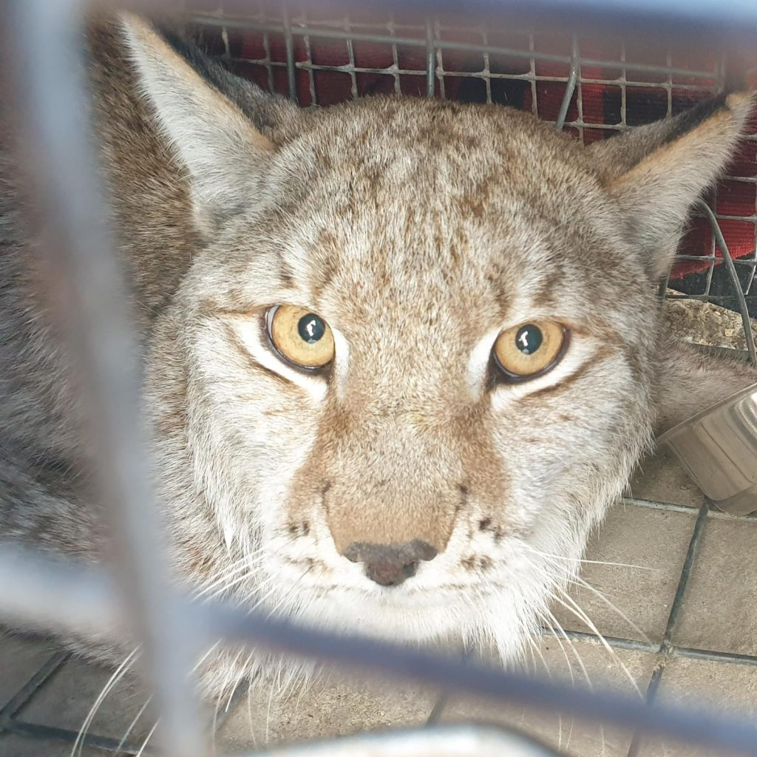
Latvia, 2021
z

Slide 9
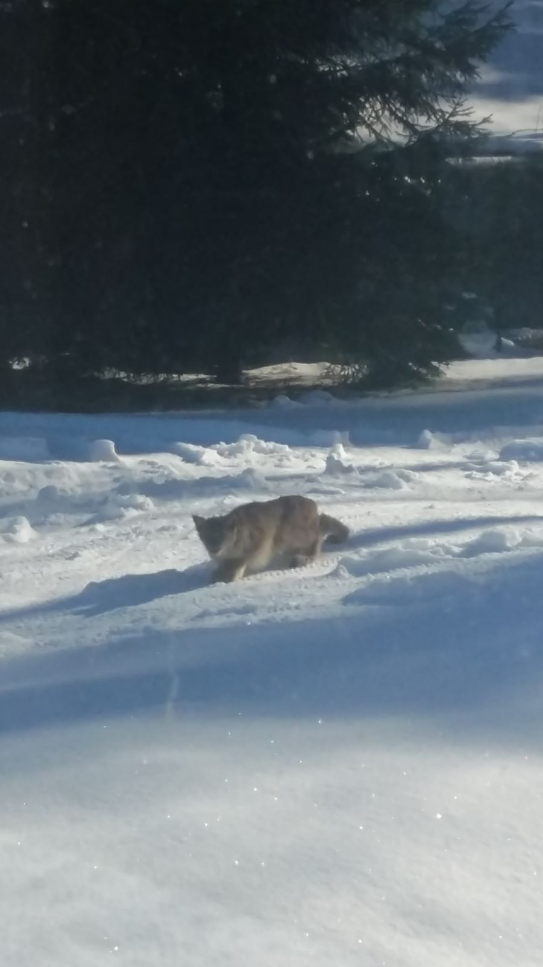
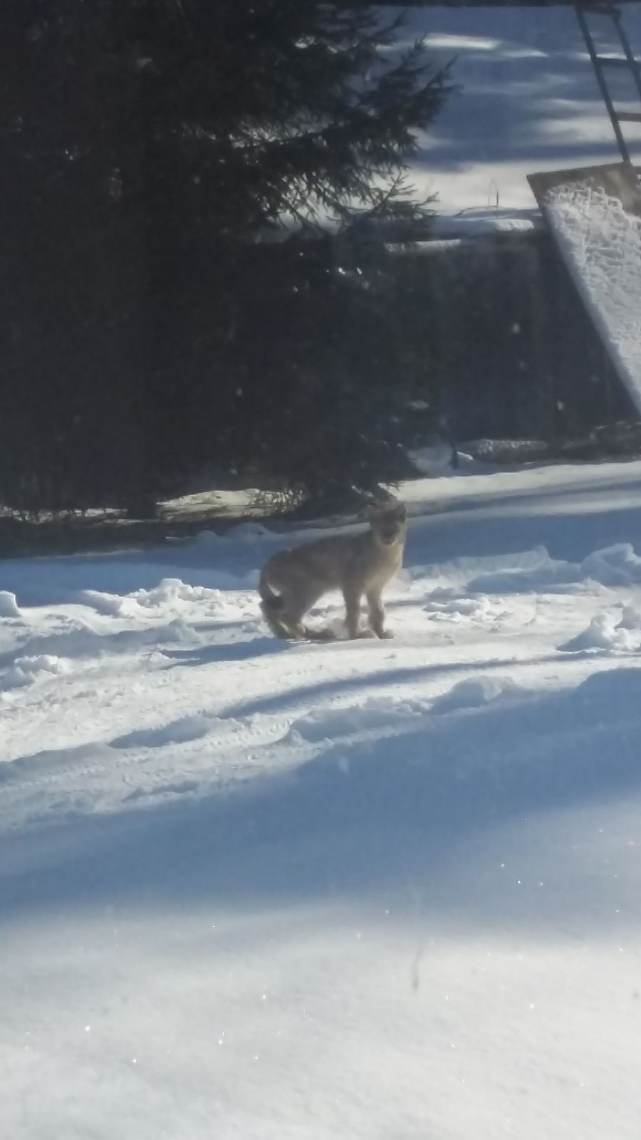
Ate 2 cats and severam chicken, 2023
z

Slide 10
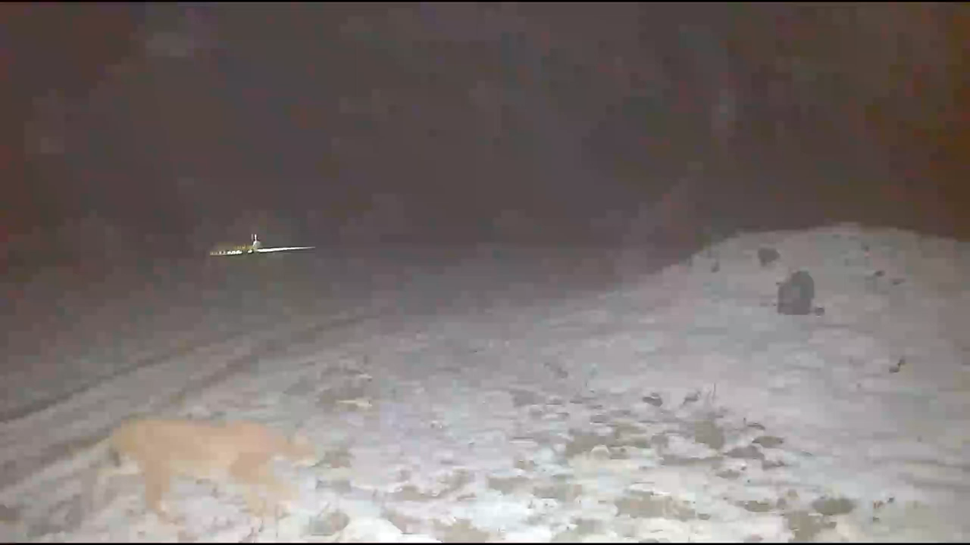
How many lynx are near the farm?

Slide 11
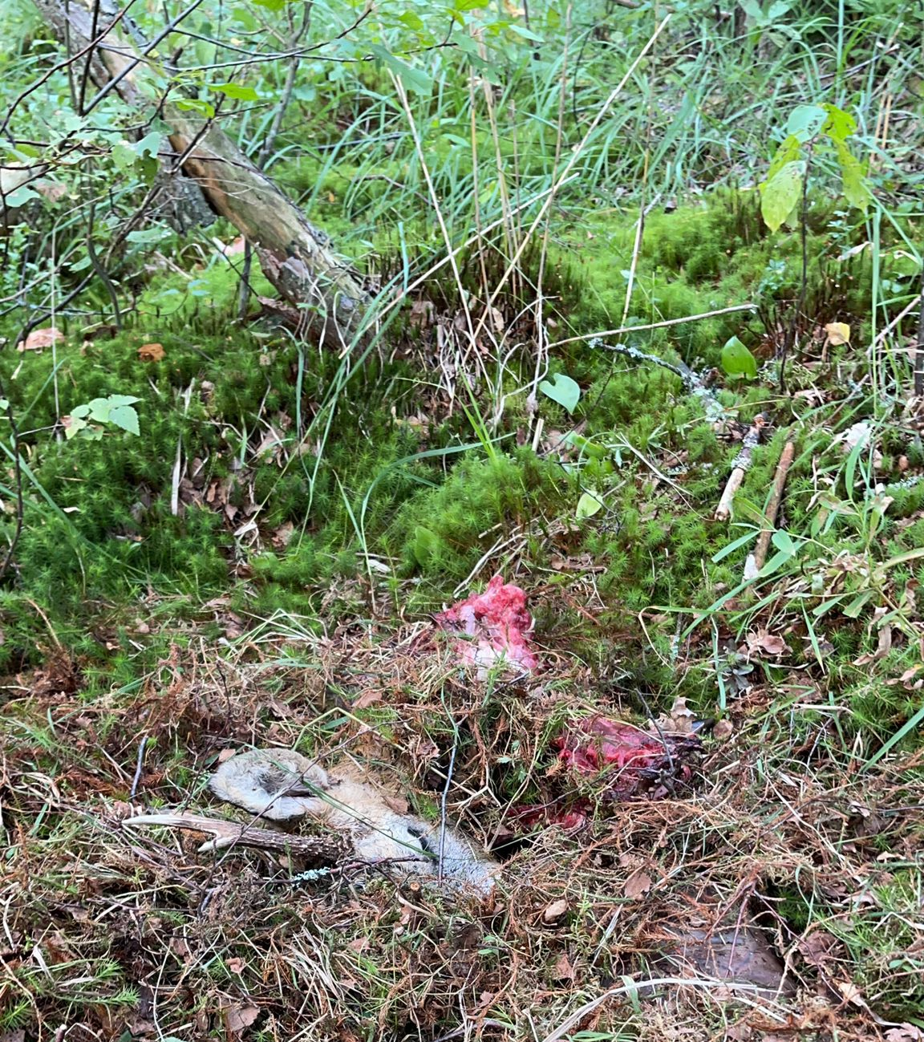
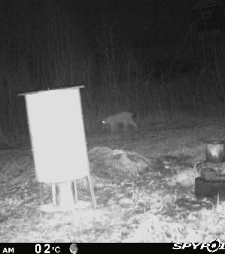
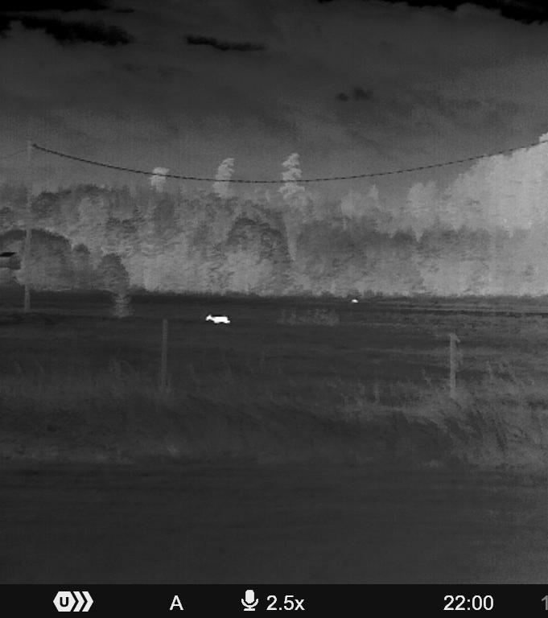
Hunter say: there are fewer roe deer
z

Slide 12
What happens next?
No information about lynx come frotm the hunters
There is no fund to treat the wounded animals
Hunters do not have respect or any liking for the animal, it is a nuisance
Nature Protection service could issue individual licences, but they are not doing that
The public still have not seen the lynx while walking the dog

Slide 13
Thank you for your attention
Conservation: Lynx hunting must be regulated to ensure the long-term conservation of lynx populations. Sustainable hunting practices, where quotas and regulations are set based on scientific assessments of lynx populations, can help maintain healthy lynx populations.
Ultimately, the question of whether lynx hunting is acceptable or not depends on various factors, including the specific circumstances in each region and the perspectives of different stakeholders. It's important for decisions about hunting to be made based on scientific research and in consideration of conservation goals and ethical considerations.

