Slide 1
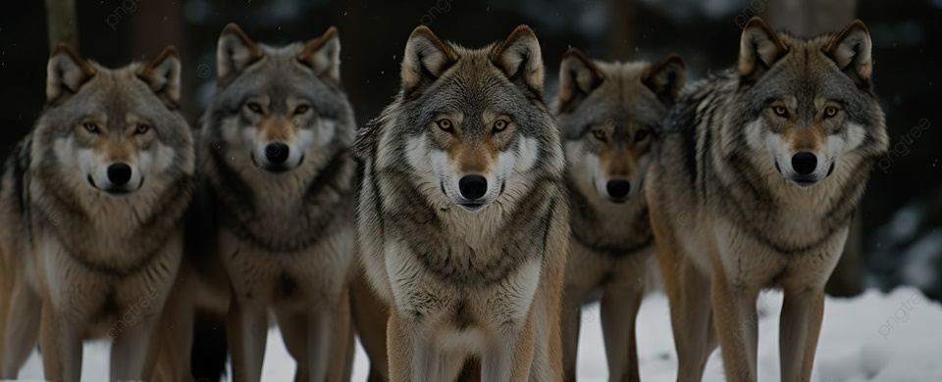
Managing/monitoring cross-border wolf populations
Miloš Ježek

Slide 2
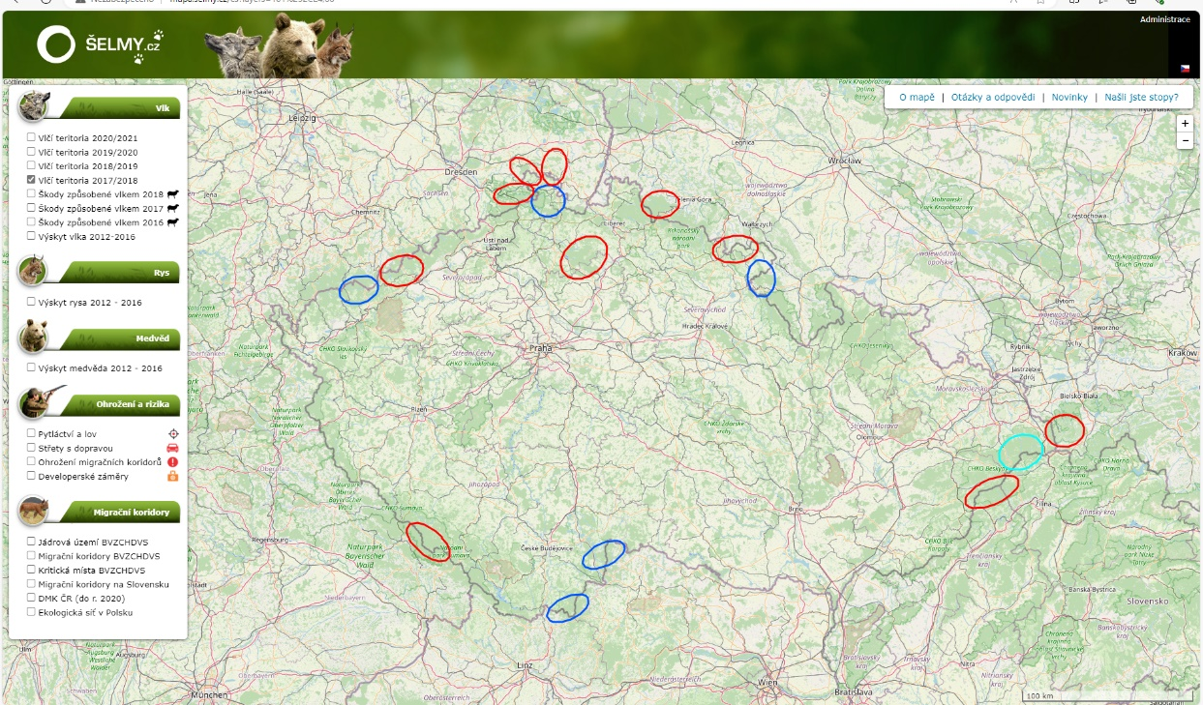
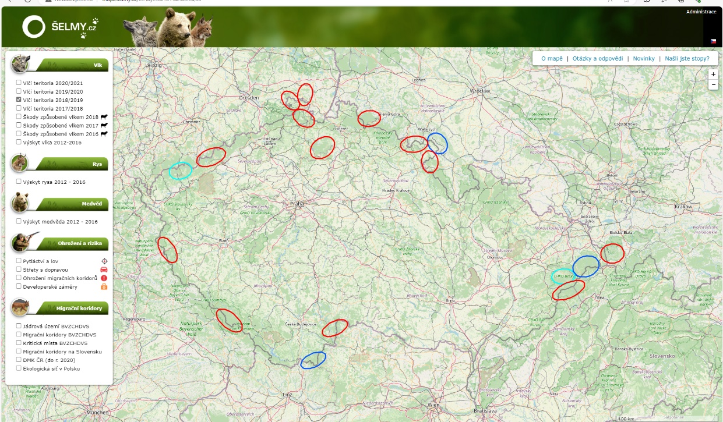
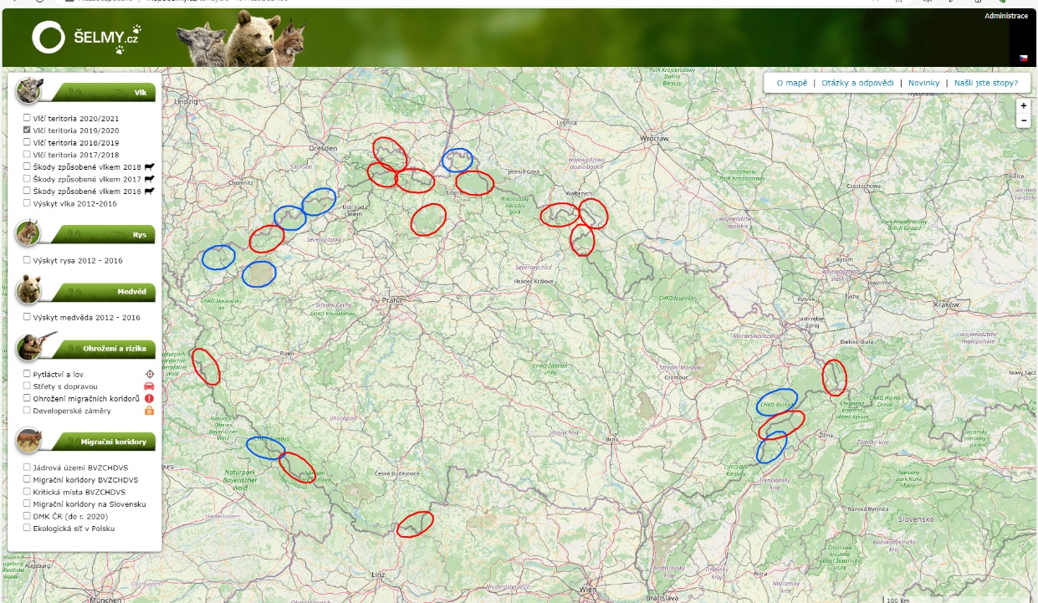
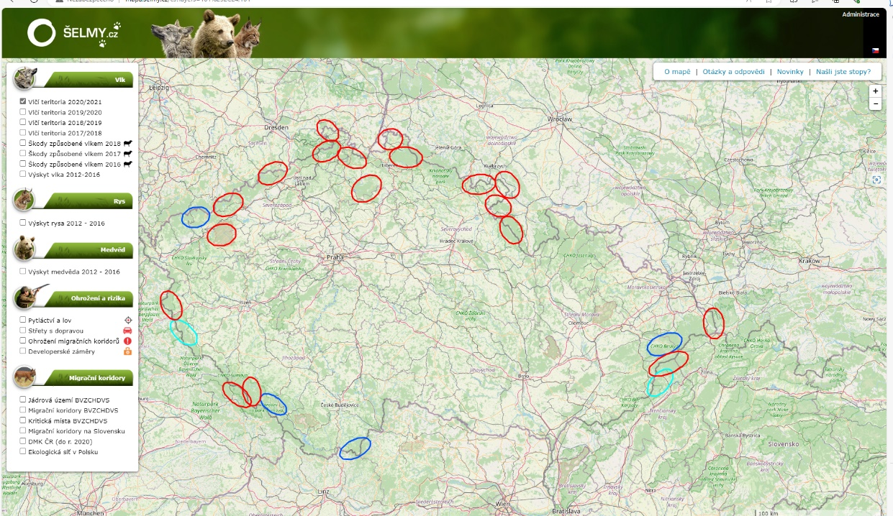
Historical and current status
2014 – 1st pair
2022 – 24 territories
2018
2019
2020
2021

Slide 3
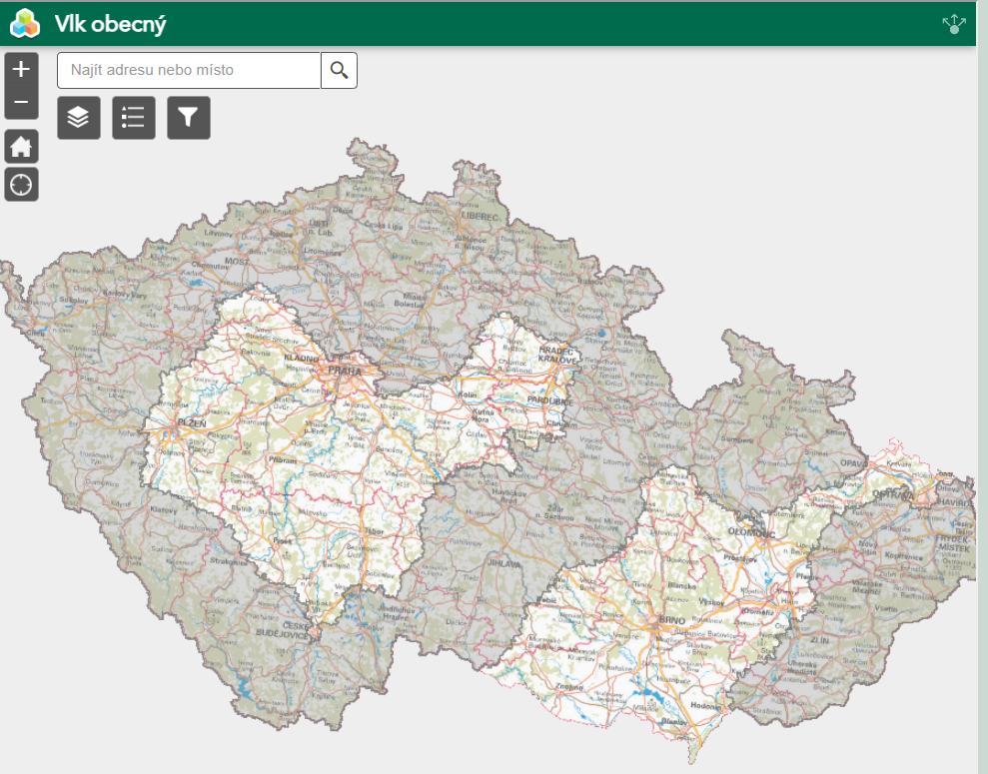
Historical and current status
2014 – 1st pair
2022 – 24 territories
2018
2019
2020
2021

Slide 4
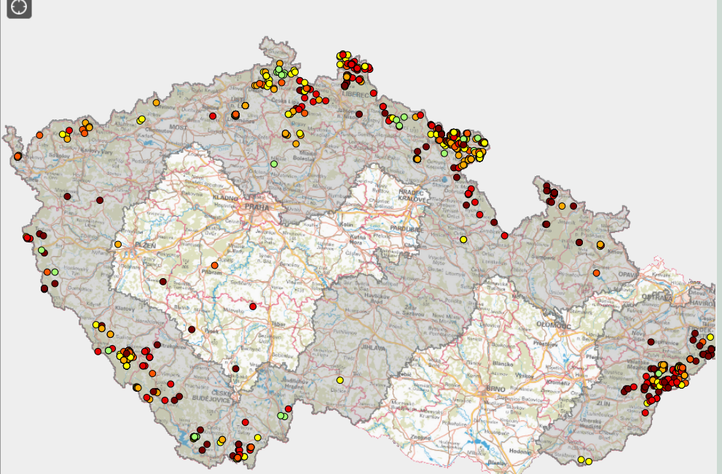
Cattle attacks
2018 | 305 pc
2019 | 427 pc | 146 attacks
2020 | 737 pc | 238 attacks
2021 | 500 pc | 190 attacks
2022 | 691 pc | 263 attacks

Slide 5
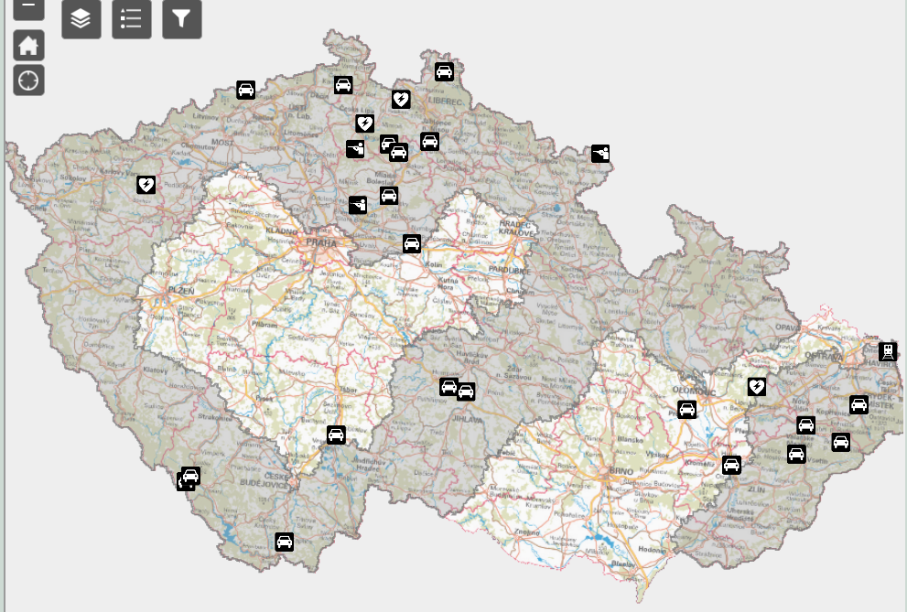
Mortality

Slide 6
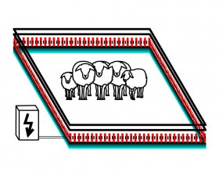
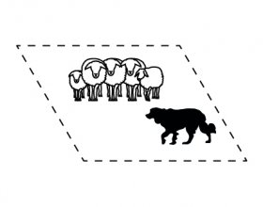
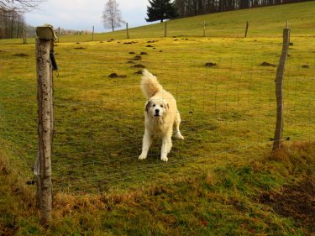
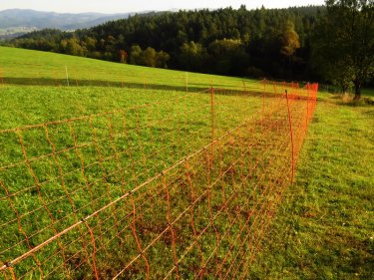
Management of the wolf population
Wolf - critically endangered protected animal species
Ministry of Environment – leading organization
2020 - Management program for wolf and Prevention program against wolf attacks on farm animals
2023 - Emergency plan for dealing with situations in the event of problem individuals of the wolf

Slide 7
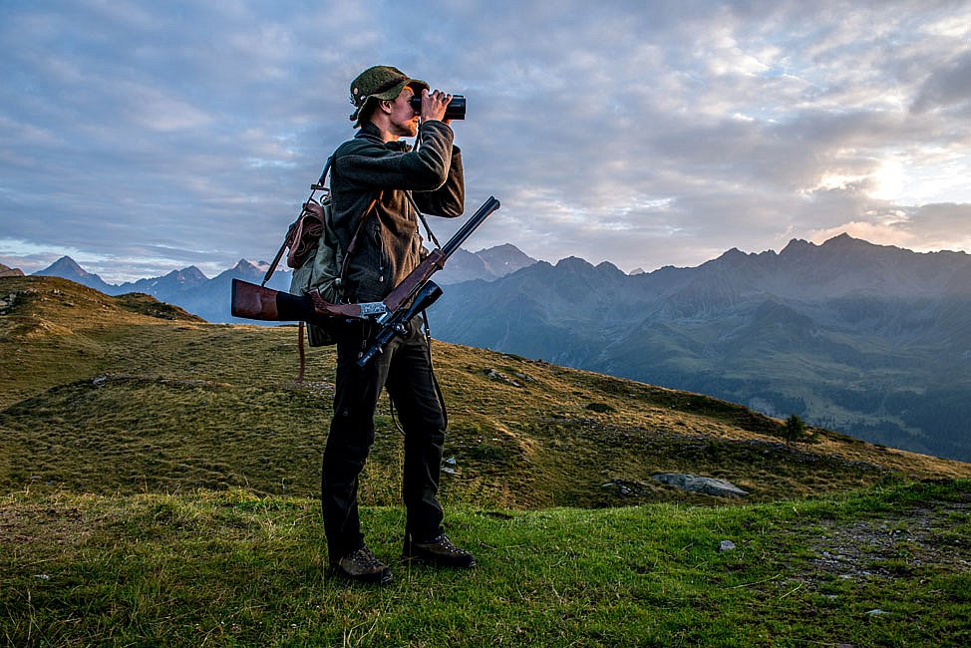
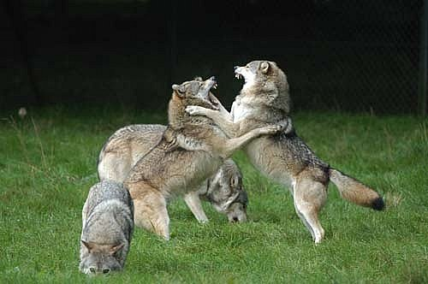
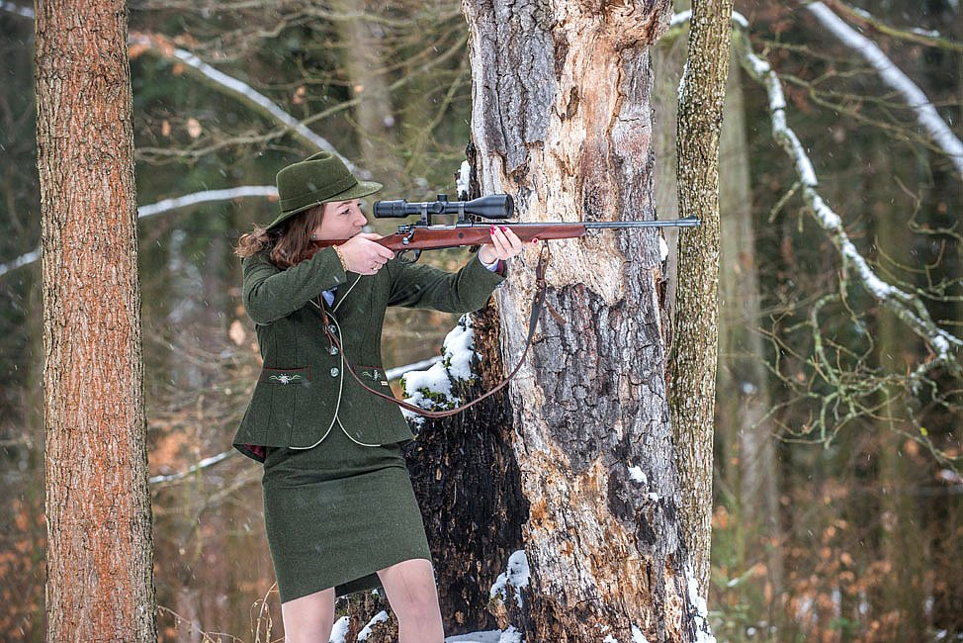
Wolf and Hunter Community
Wolf - part of the hunting law
Hunters are directly involved into the Emergency plan
Owner of hunting area = owner of all cadavers of wolf

Slide 8
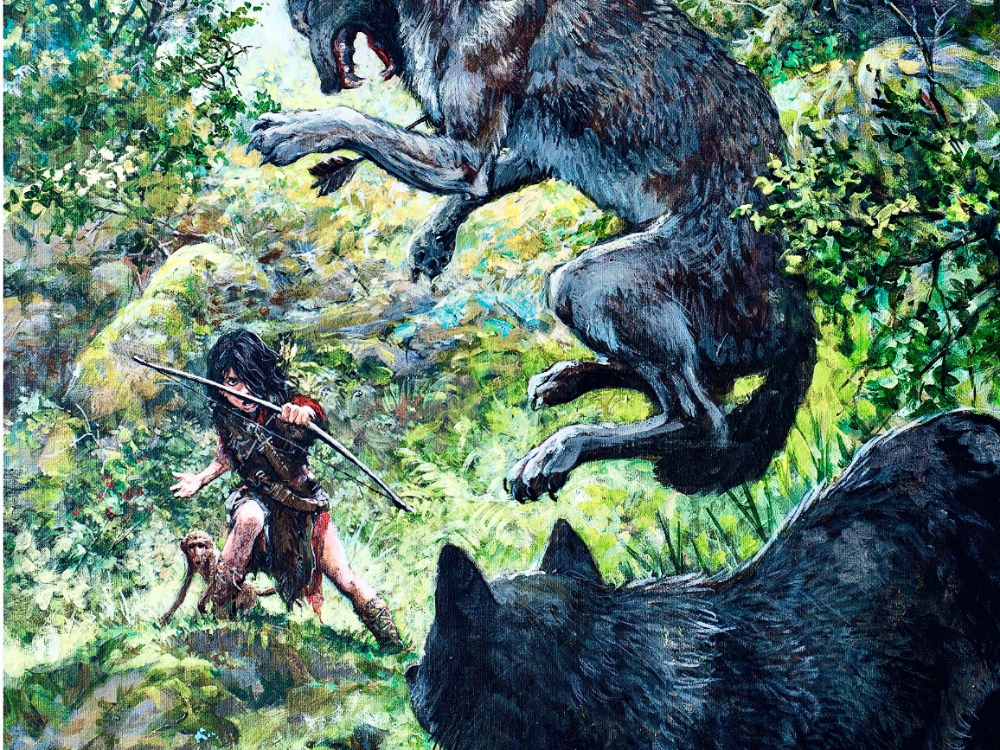
Wolf and Hunter Community
Why are/should be hunters interested in the wolf management?
Historical consequences
2. Competition for the prey
3. Danger to hunting dogs
NO

Slide 9
Wolf and Hunter Community
Why are/should be hunters interested in the wolf management?
Historical consequences
2. Competition for the prey
3. Danger to hunting dogs
NO
YES, BUT….

Slide 10
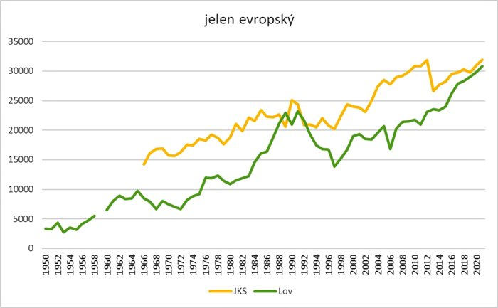
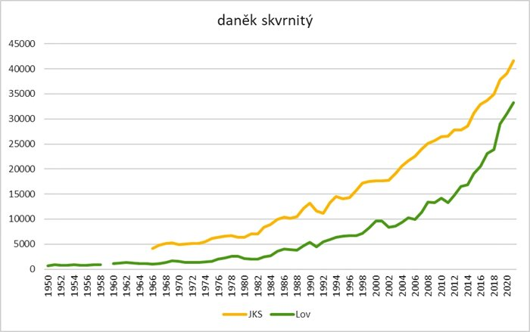
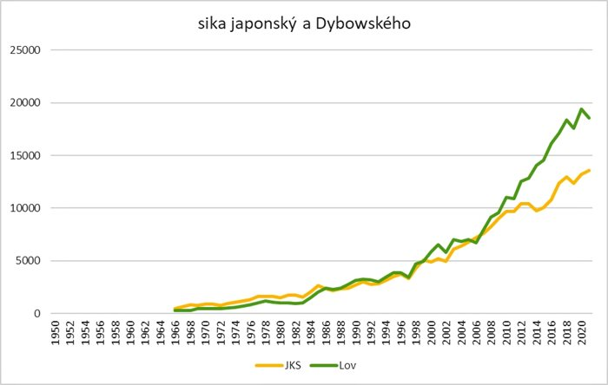
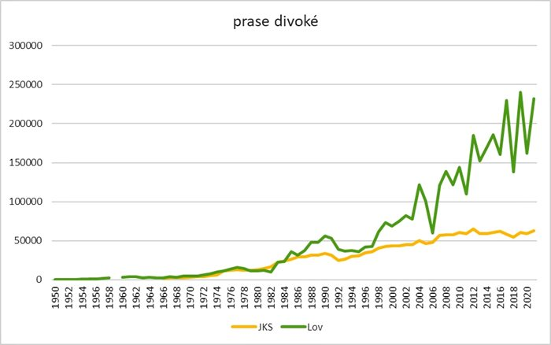
Wolf and Hunter Community
Why are/should be hunters interested in the wolf management?
Historical consequences
2. Competition for the prey
3. Danger to hunting dogs
YES, BUT….
Red deer
Wolf presence
Fallow deer
Wolf presence
> 400 000 pc hoofed animals hunted in 2022/3
> 50 pc/1 000 ha
1 wolf pack – 120 pc/ 10 000 ha
Sika deer
Wolf presence
Wild boar
Wolf presence
1 wolf pack – 12 pc/ 1 000 ha
=
10% (780 packs)

Slide 11
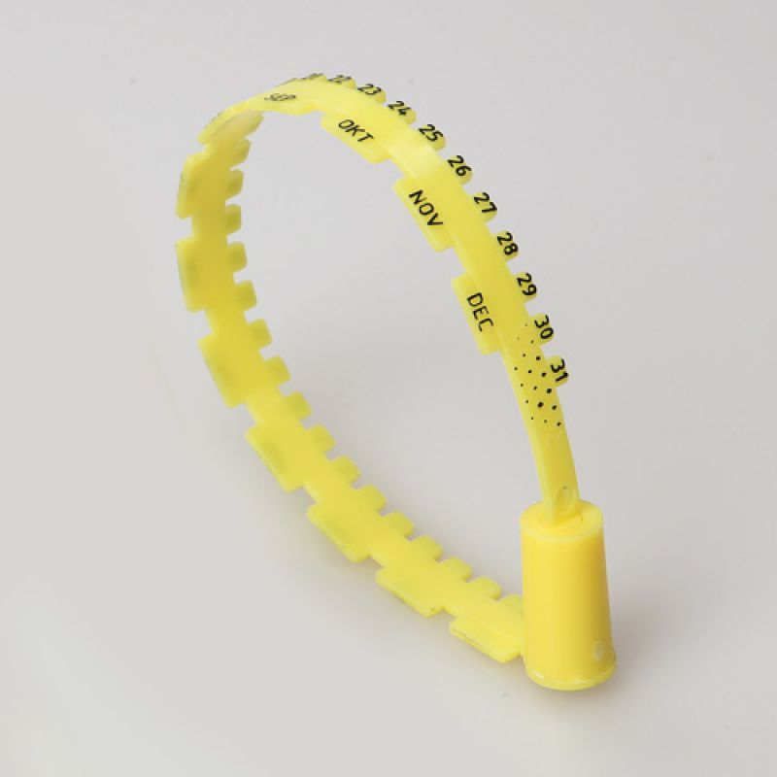
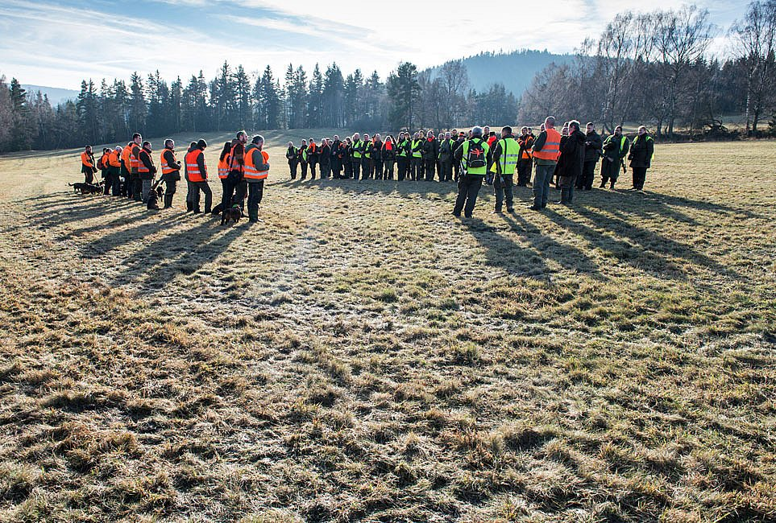
Wolf and Hunter Community
Why are/should be hunters interested in the wolf management?
Historical consequences
2. Competition for the prey
3. Danger to hunting dogs
YES, BUT….
Red deer
Wolf presence
Fallow deer
Wolf presence
< 400 000 pc hoofed animals hunted in 2022/3
Sika deer
Wolf presence
Wild boar
Wolf presence

Slide 12
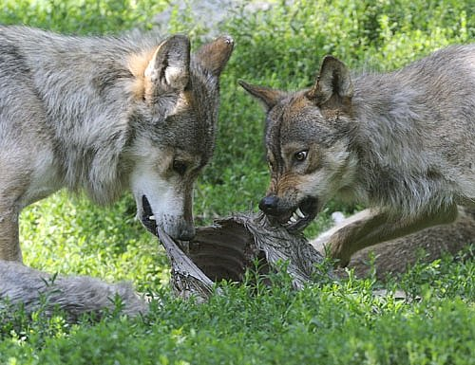
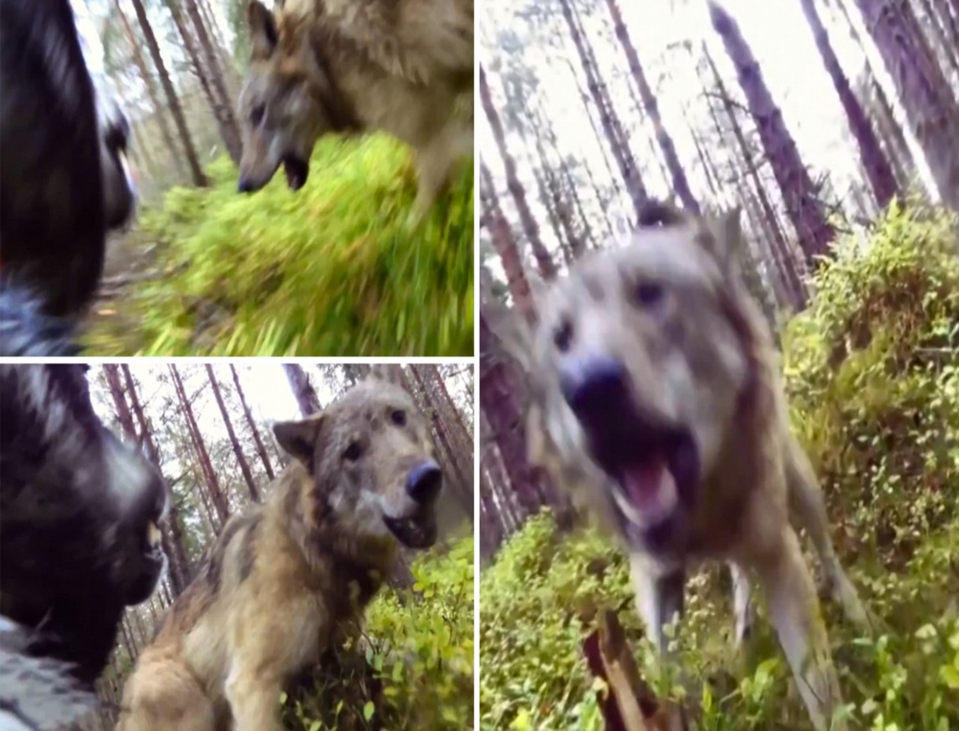
Wolf and Hunter Community
Why are/should be hunters interested in the wolf management?
Historical consequences
2. Competition for the prey
3. Danger to hunting dogs
NO
YES, BUT….
YES

Slide 13
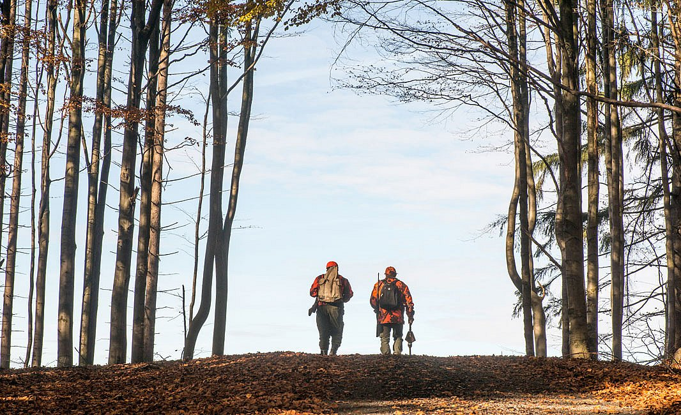
Wolf and Hunter Community
Should hunters be exclude from main stream of the wolf management ?

